Slide 1
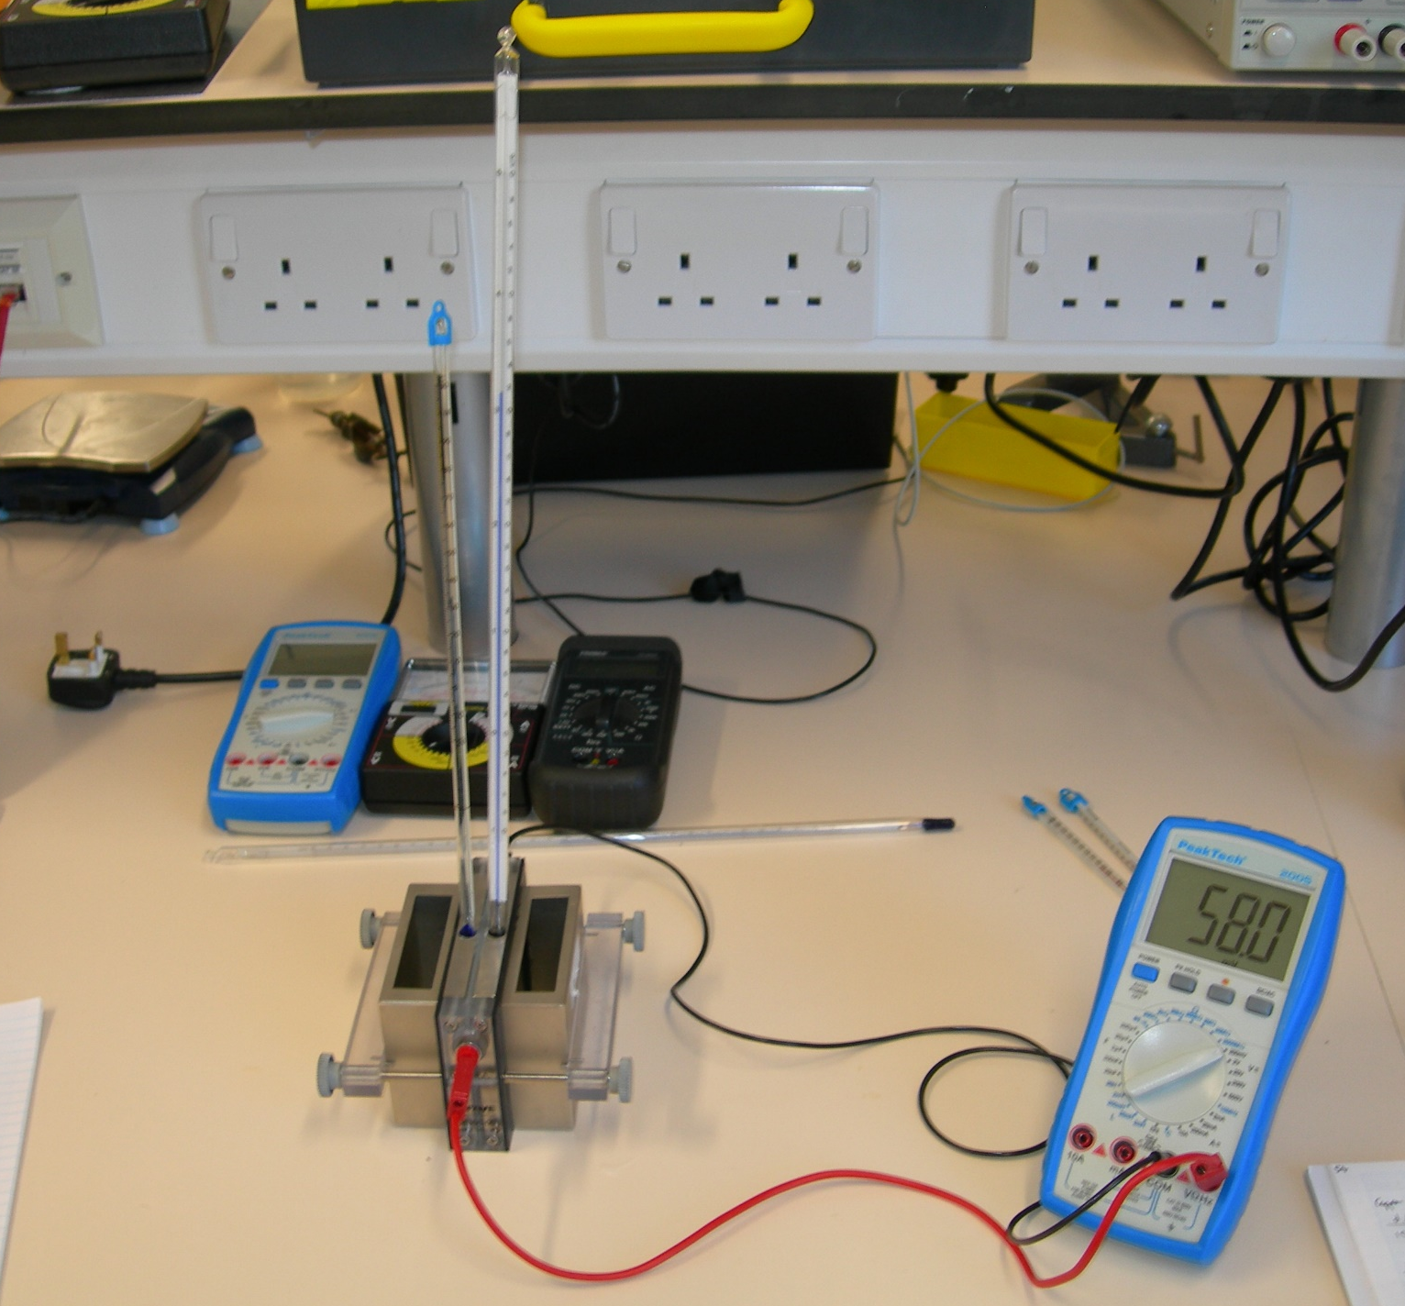
Thermometers
Water Baths
Voltmeter
Thermoelectric Module

